Slide 1

Flight Landing Analysis
By
Anukriti Sharma, Pranav Naphad, Sairam Akuthota, Maheswara Nagiri, Amar Hadagali

Slide 2
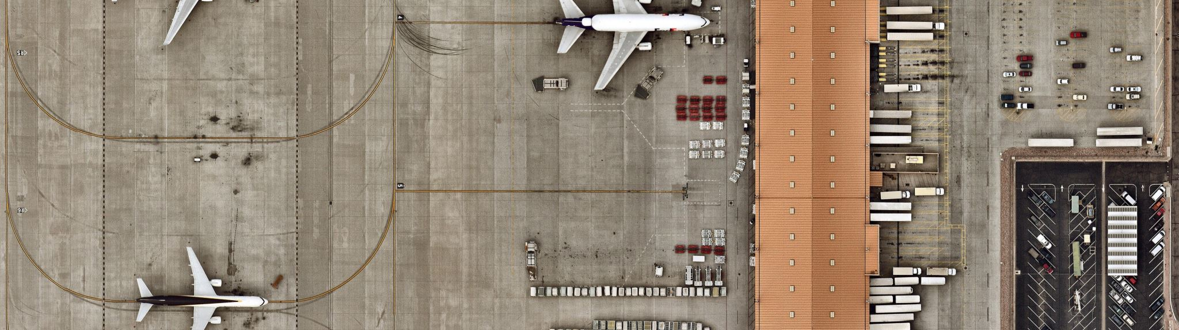
Goal of the Project
Analyze the factors impacting landing distance of commercial flight to reduce the risk of runway overruns

Slide 3

Data and Variables
Landing data from 800 commercial flights.
Variable Dictionary: 1. Aircraft: The make of an aircraft (Boeing or Airbus) 2. Duration (in minutes>40) 3. The number of passengers in a flight 4. Ground Speed (30mph-140mph) 5. Air Speed (30mph-140mph) 6. The height of an aircraft when it is passing over the threshold of the runway (in meters=> 6meters) 7. Pitch angle of an aircraft when it is passing over the threshold of the runway (in degrees) 8. The landing distance of an aircraft which is typically less than 6000ft.

Slide 4
Technologies
JMP used to make decision tree
Programming language – R

Slide 5
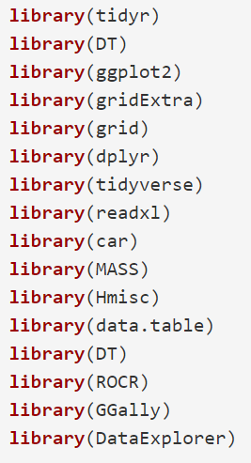
R Libraries

Slide 6
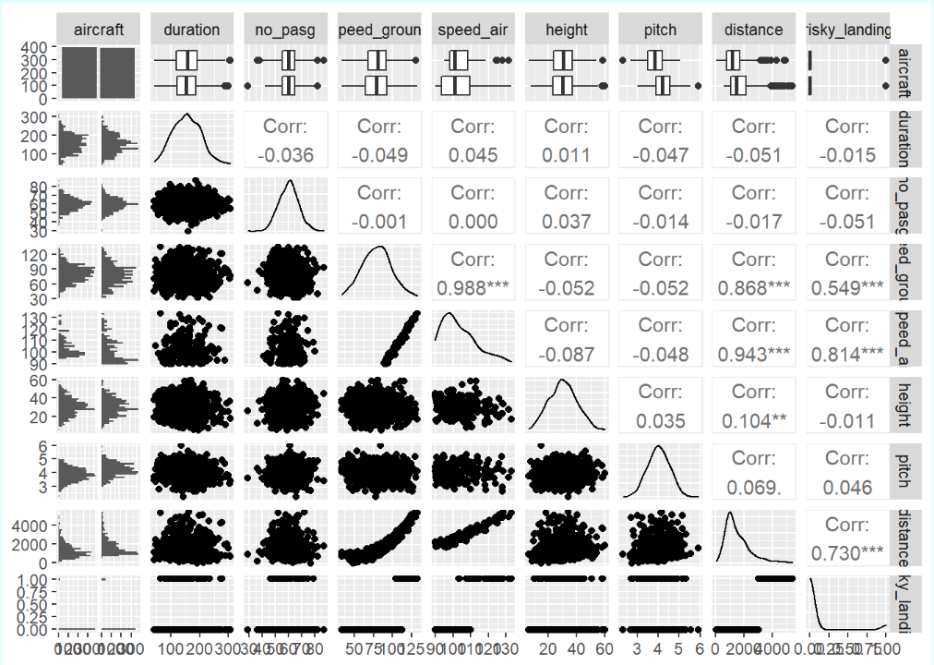
After cleaning the data, we got 800 rows and 8 columns which means that there were no duplicates in the dataset
The number of outliers is just 19 which is not too high thus we can remove them from the data set that we want to work on. A total of 781 observations remain after removing outliers.

Slide 7
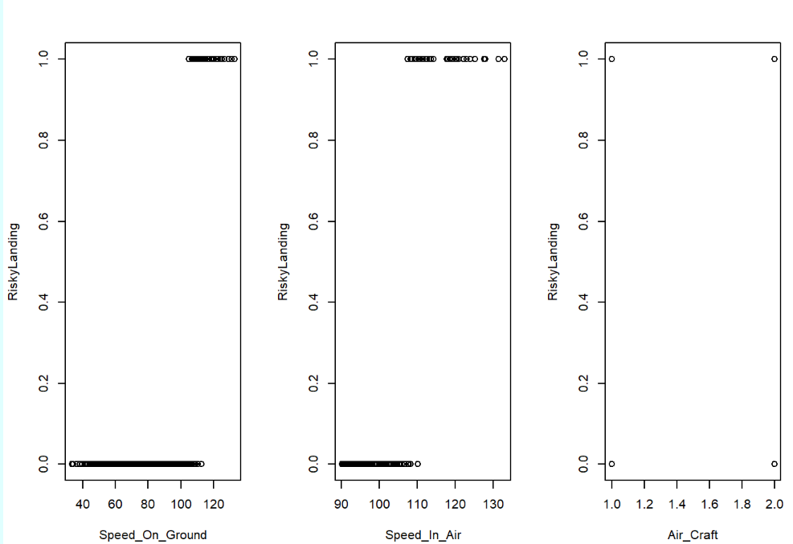
Single factor regression analysis
The variables which can be considered significant for our model analysis (p-value < 0.05) are: • Speed_ground • Speed_air • Aircraft
From the plots, we can observe the following: • There is a change of risky landing with increase in speed ground. • We also observe the same change with speed air.

Slide 8
Final Full Model for Risky Landing
• The model has the following characteristics: AIC: 30.91 BIC: 43.82 • The risky landing can be expressed as a linear function of the above two parameters. • Keeping other factors constant, a unit increase in speed ground increases the odds of risky landing by 2.814. • Keeping other factors constant, a unit increase in pitch increases the odds of risky landing by 21.673.
Unlike the AIC, BIC penalizes the model more for its complexity meaning that more complex model will have a worse/larger score and will in turn be less likely to be selected

Slide 9
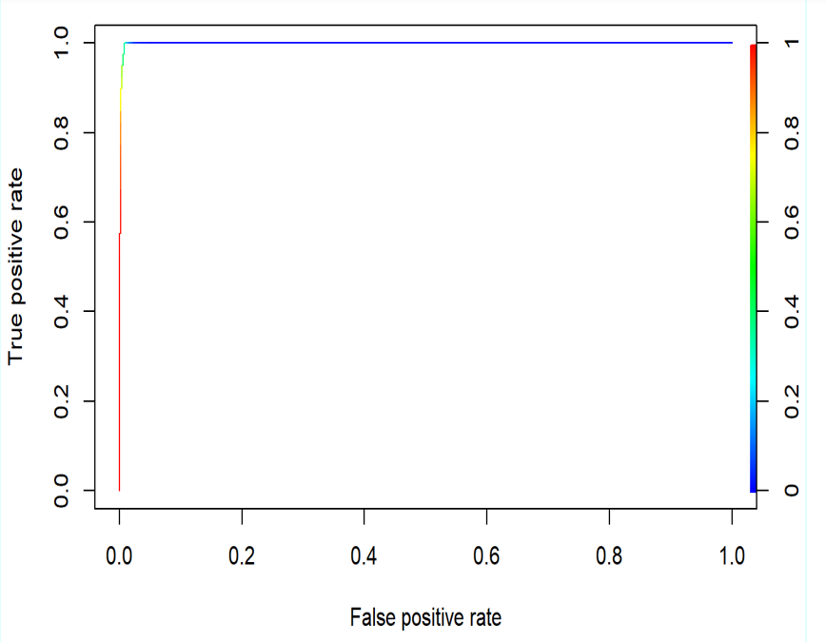
ROC Curve
Observation • Area under Curve value: 0.998

Slide 10
Confusion matrix and Misclassification rate
 | Predicted Non-Risk Landing | Predicted Risk Landing
Actual Non-Risk Landing | 497 | 9
Actual Risk Landing | 0 | 40
• In Sample Misclassification rate of the model with is 0.0164 • Out Sample Misclassification rate of the model with is 0.1593

Slide 11
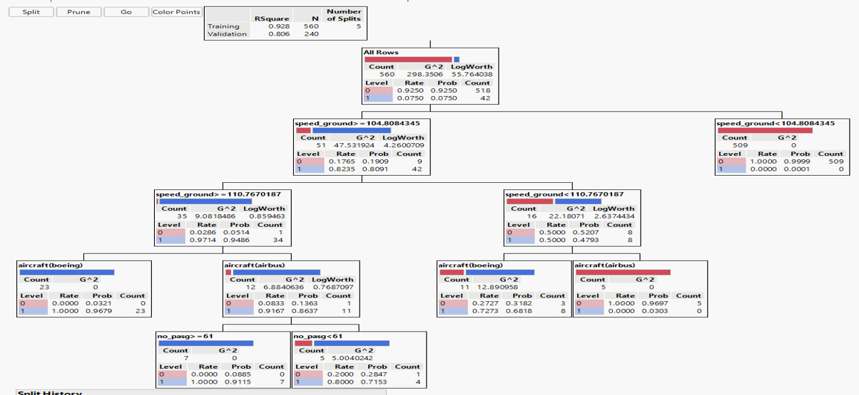
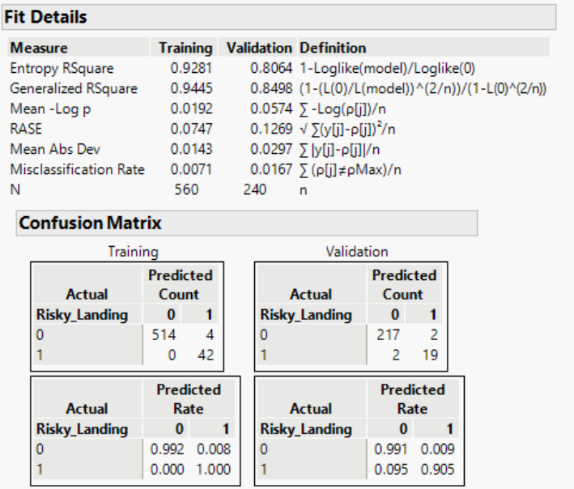
Decision Tree

Slide 12
CONCLUSION
Model | AUC | Misclassification Rate (Train Data) | Misclassification Rate (Test Data)
Logistic Regression | 0.998 | 0.16 | 0.0164
Classification Tree | 0.9967 | 0.0071 | 0.0167
After comparing the above parameters, we can say the best model is Classification Tree for the prediction of landing distance being within the risky category or not. As its accuracy and Misclassification rate both are optimal.
The Federal Aviation Administration can find this analysis valuable for designing the airports. There are some types of planes that need landing runway to be more than 6000 like cargo carriers etc., but for small local airports this prediction will assist the FAA architects to plan the airport. The similar type of analysis can also be done for other heavy planes.

Slide 13

THANK YOU

